Slide 1

PowerVC and OpenStack – Similarities and Differences
Naveen Kumar B

Slide 2
OpenStack
OpenStack is a cloud operating system that controls large pools of compute, storage, and networking resources throughout a datacenter, all managed through a dashboard (like GUI front-end tool) that gives administrators control while empowering their users to provision resources through a web interface.
OpenStack at its core is an open source project - it's free code. But what makes OpenStack come alive are the vendors that have contributed to make that raw code and then turned it into a product businesses can use.
Some companies have used OpenStack as the basis for their public clouds; Rackspace, for example, has proven that OpenStack can power a massive, geographically distributed cloud.

Slide 3
IBM POWERVC (Power Virtualization Center)
PowerVC is a cloud management tool/application from IBM which can be installed on a Linux server. With the help of the GUI we can manage the virtualization of Power Systems(stop/start LPARs, create/delete/migrate LPARS, add storage to them…).
It is based on the OpenStack initiative, which is an opensource cloud management project without any hardware dependency. PowerVC is using the components of OpenStack.

Slide 4
IBM POWERVC (Power Virtualization Center)
When a Power server is controlled by PowerVC, it can be managed:
- By the graphical user interface (GUI)
- By scripts containing the IBM PowerVC REST APIs
- By higher-level tools that call IBM PowerVC by using standard OpenStack API

Slide 5
IBM POWERVC (Power Virtualization Center)
In PowerVC these terms are used: Host: This is a Power server (same as in HMC the Managed System) VM: Virtual Machine, which is running on a Host (same as an LPAR) Image: This is a copy of a VM which can be used for fututre VM creations (it is a basically a disk copy of rootvg) Volume: This is a disk or LUN Deploy: When we create a new VM from an Image, it is called Deploying a new VM

Slide 6
NOVALINK
Using PowerVC, we have 2 options to manage Power servers. It can go through an HMC or a NovaLink LPAR. If we choose Novalink, a special partition on each Power server is needed. This will do the same functions as an HMC. (A combined solution is also possible, where both HMC and NovaLink exist together.)

Slide 7
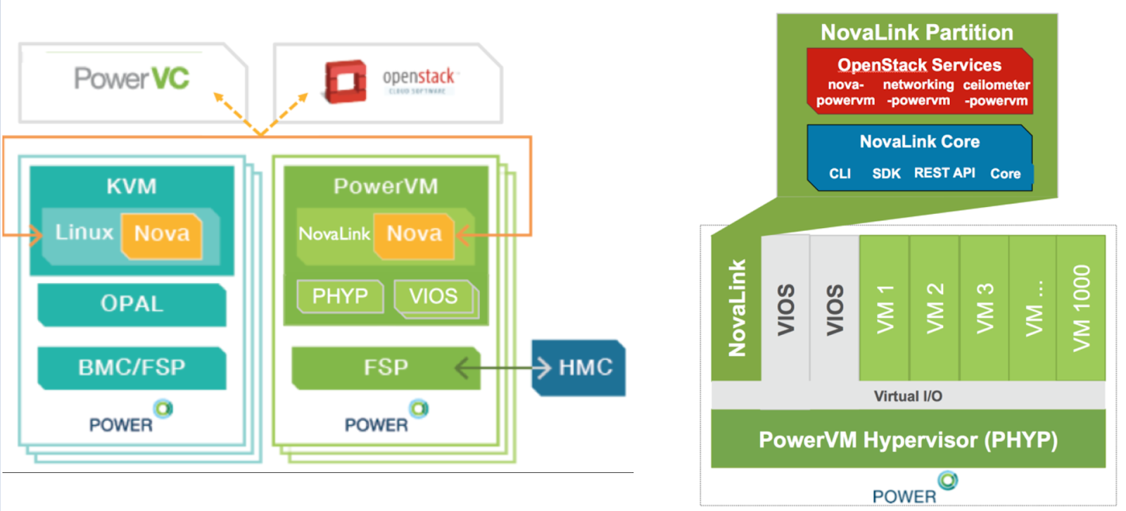

Slide 8
NOVALINK
The NovaLink architecture enables OpenStack to work with PowerVM (and PowerVC) by providing a direct connection to the Power server (rather than communicating through an HMC).
In an existing HMC-managed environment, PowerVC can manage up to 30 hosts and up to 3000 VMs. In a NovaLink based environment, PowerVC can manage up to 200 hosts and 5000 VMs. It is possible to use PowerVC to manage PowerVM NovaLink systems while still managing HMC managed systems as well.
NovaLink is enabled via a software package that runs in a Linux VM on a POWER8 host. NovaLink provides a consistent interface (with other supported Hypervisors such as KVM), so OpenStack services can communicate with the LPARs consistently through the NovaLink partition.

Slide 9
PowerVC and Openstack
PowerVC is built on Openstack, so the main OpenStack functions are built into PowerVC as well. These functions are:
- Image management (in OpenStack it is called "Glance")
- Compute (VM) management (in Openstack it is called "Nova")
- Network management (in OpenStack it is called "Neutron")
- Storage management (in OpenStack it is called "Cinder")

Slide 10
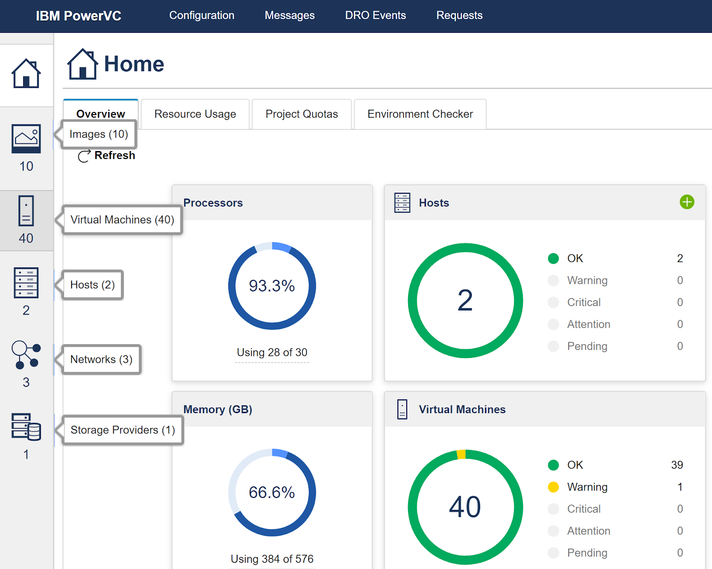

Slide 11
Deploying Virtual Machines (Host Group - Placement Policy)
In order to use PowerVC and to create new VMs, we need Images, Hosts, Networks and Storage space. A new LPAR is created from an Image, and during creation we need to choose which Power Server (Host) and which Network to use.
Power servers are called "Hosts" in PowerVC. After adding several Hosts to PowerVC, we can group these Hosts by creating "Host Groups". Each Host Group has a Placement Policy, which controls where (on which host) our new VMs are created.

Slide 12
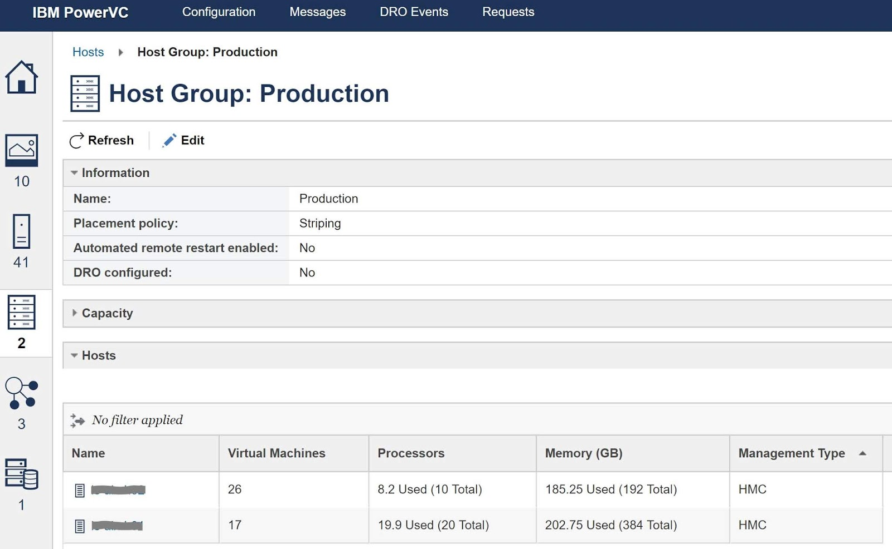

Slide 13
Deploying Virtual Machines (Host Group - Placement Policy)
For example if we choose the policy "Memory Utilization Balanced", our new VM will be deployed on that host where the memory utilization is the lowest. Every host must be in a host group and during migration VMs are kept within the host group. Out of the box, PowerVC comes with a “default” host group (a special group that can’t be deleted), that will house any host that is registered with PowerVC but not added to a specific host group.

Slide 14
Deploying Virtual Machines (Host Group - Placement Policy)
Placement policies:
- Striping: It distributes VMs evenly across all hosts. (CPU/RAM/Storage/Network)
- Packing: It places VMs on a single host, which contains the most VMs (until its resources are fully used )
- CPU utilization balance: It places VMs on the host with the lowest CPU utilization in the host group.
- CPU allocation balance: It places VMs on the host with the lowest percentage of its CPU that is allocated to VMs.
- Memory utilization balanced: It places virtual machines on the host that has the lowest memory utilization in the host group
- Memory allocation balance: It places VMs on the host with the lowest percentage of its memory that is allocated post-deployment or after relocation

Slide 15
Deploying Virtual Machines (Host Group - Placement Policy)
When a new host is added to a host group and the placement policy is set to striping mode, new VMs are deployed on the new host until the resource usage of this host is about the same as on the previously installed hosts (until it catches up with the existing hosts).
The placement policies are predefined, it is not possible to create new policies, and if during VM deployment we choose a specific host (and not a Host group), then the placement policy is ignored for that VM.

Slide 16
Collocation rules
While Placement Policies are related to Hosts (which Host should be used for VM creation), Collocation Rules are making relationships between VMs (they are telling which VM should or should not run together with other VMs on the same Host). A collocation rule has also a policy, which can be either “affinity” or “anti-affinity”.
An affinity rule means that VMs in the collocation rule must be running on the same host (“best friends”) and an anti-affinity rule means that the VMs need to be running on different hosts (“worst enemies”). PowerVC is following these rules when performing live migration, remote restart or host evacuation operations (any mobility operation). Automation becomes much simpler as we don't need to keep these rules in mind.
You can add a VM to a collocation rule only after deployment (doing this at deployment time is not possible). Collocation rules can be created in the "Configuration" menu under "Collocation Rules".

Slide 17
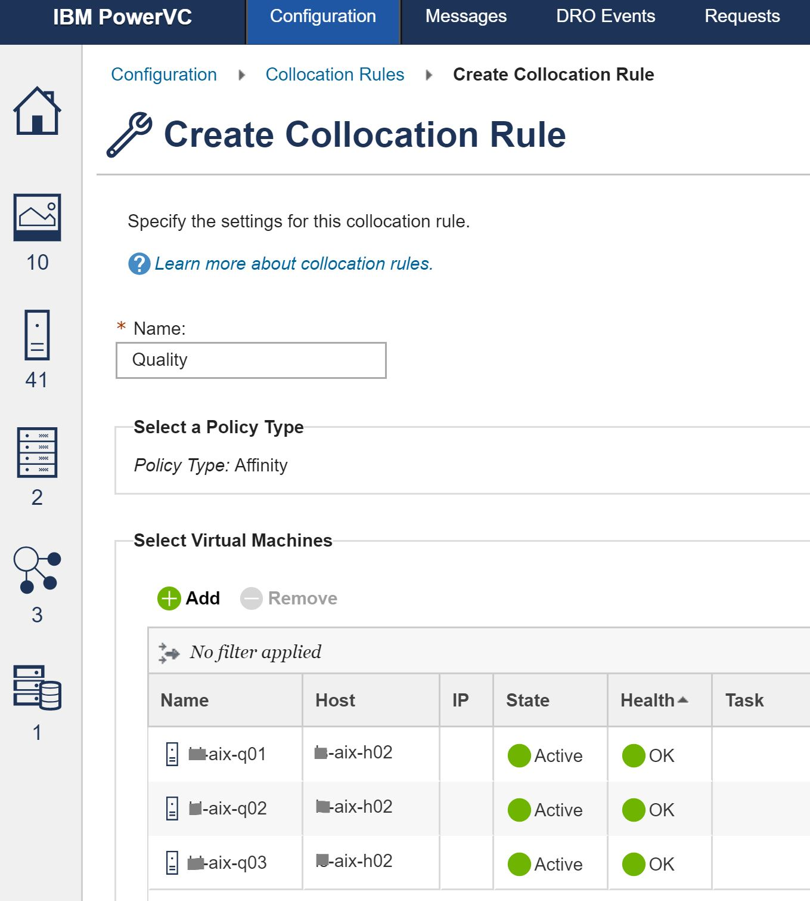

Slide 18
Templates in PowerVC
Rather than defining all characteristics for each VM (CPU/RAM…) or each storage unit that must be created, we can use a template that was previously defined.
Three types of templates are available:
- Compute templates: These templates are used to define processing units and memory that are needed by a partition.
- Deploy templates: These templates are used to allow users to quickly deploy an image. (more details below)
- Storage templates: These templates are used to define storage settings, such as a specific volume type, storage pool, and storage provider.

Slide 19
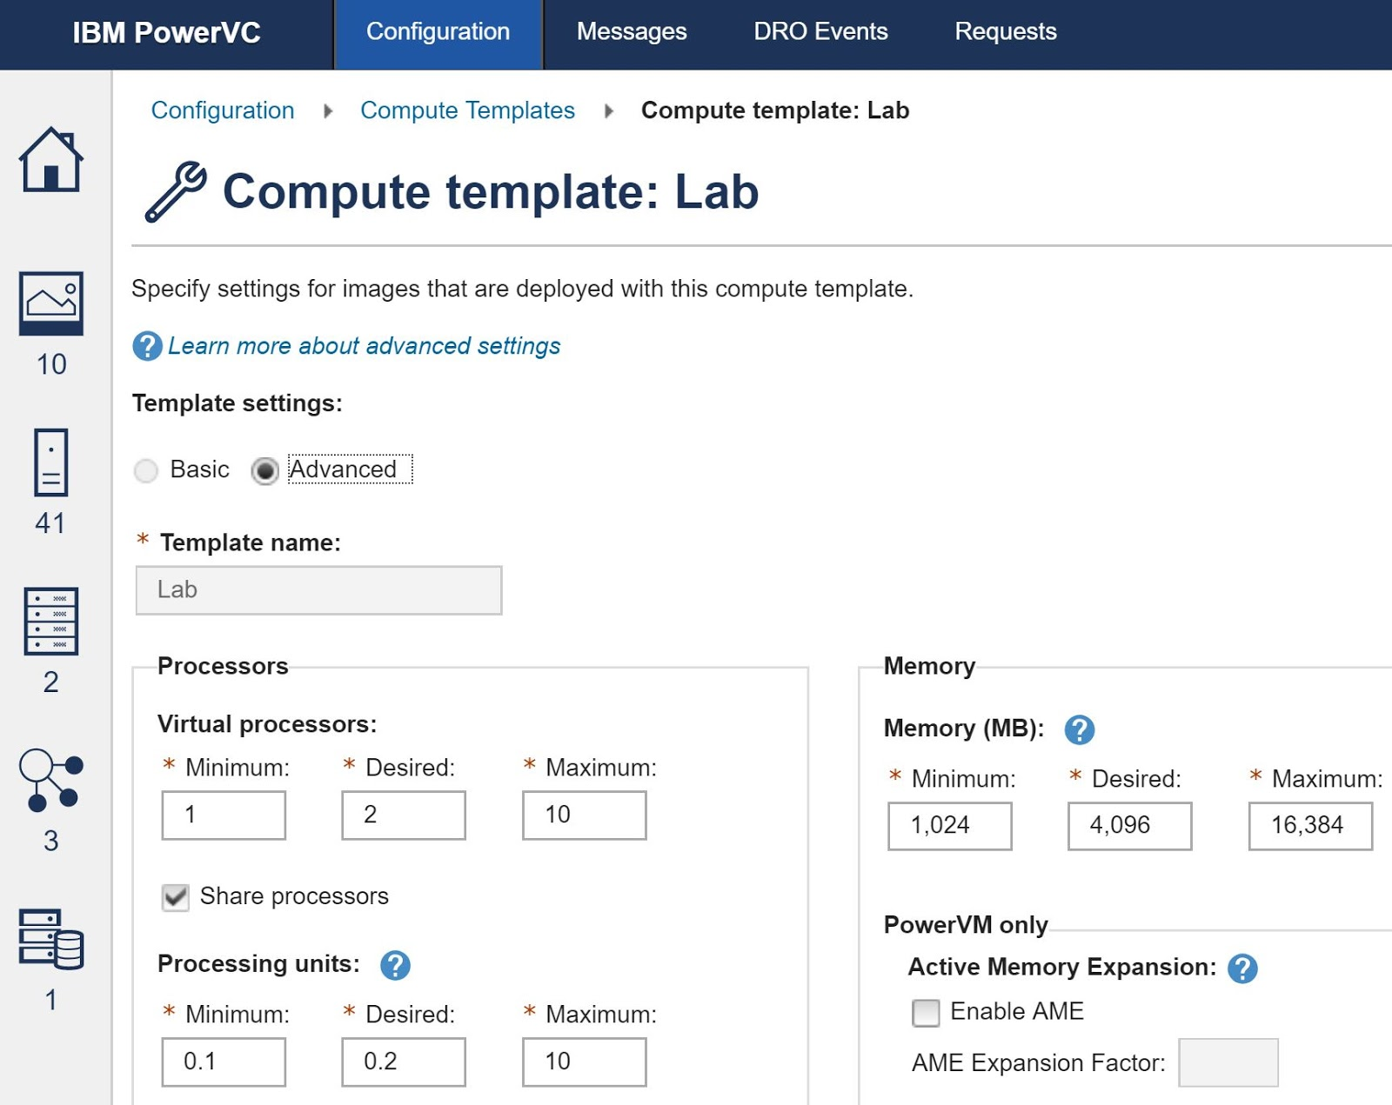

Slide 20
Templates in PowerVC
Deploy templates:
A deploy template includes everything necessary to create quickly a VM. It includes:
- the deployment target (a Host group or a specific Host), Storage Connectivity Group and any other policies
- compute template (needed CPU, RAM configuration)
- which image to use during deployment
- network (VLAN) needed for the new VM
- any other scripts which will be called during first boot (this section is handled by cloud init)

Slide 21
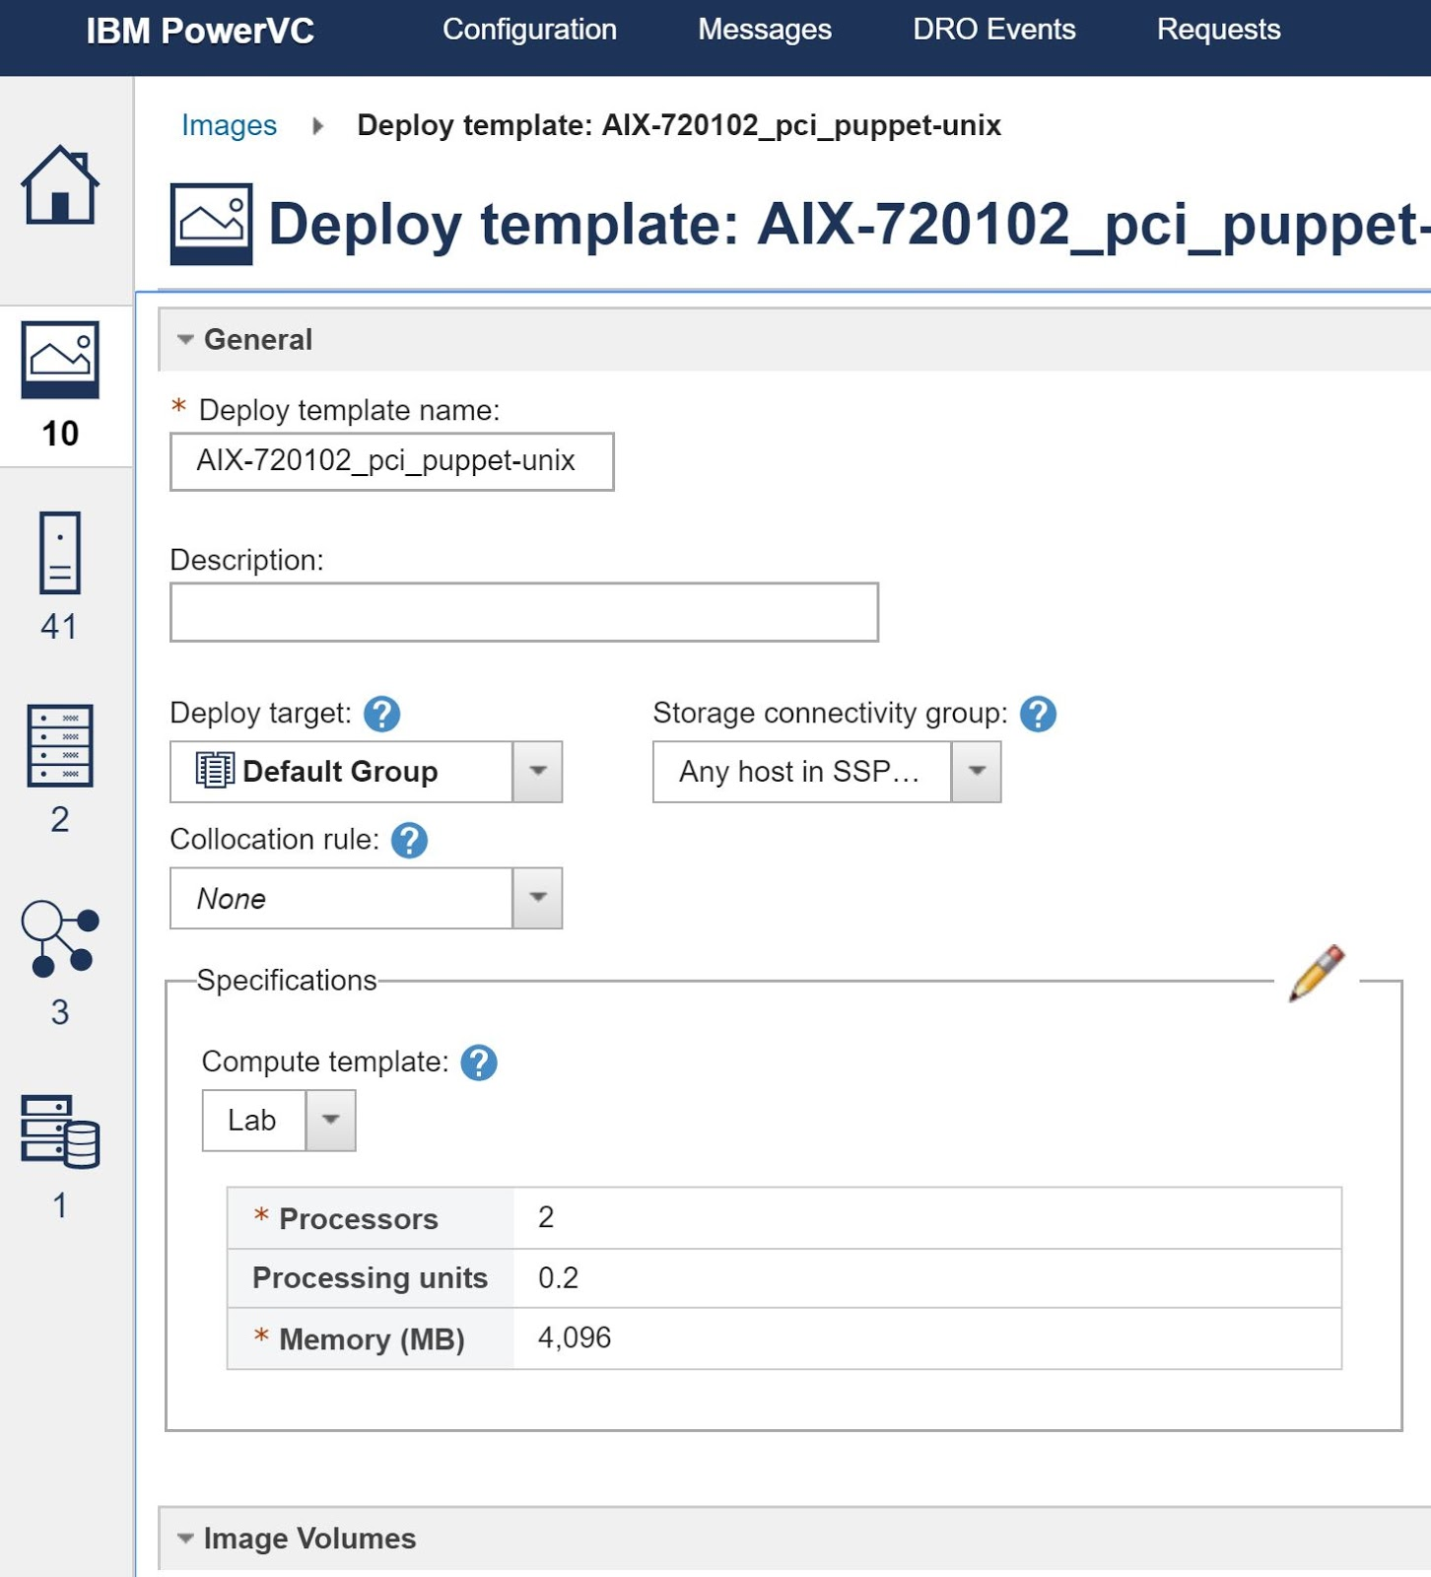

Slide 22
Templates in PowerVC
A deploy template basically is just a bunch of information which will be needed for the creation of the new VM. Comparing to an image, deploy templates are not using storage space.
Creating Deploy Templates:
1. From the Images window, select the image that you want to use to create a deploy template and click Create Template from Image.
2. Fill out the information in the window that opens, then click Create Deploy Template.
3. The deploy template is now listed on the Deploy Templates tab of the Images window.

Slide 23
STORAGE in PowerVC
Storage provider: Any system that provides storage volumes. (SVC, EMC...or SSP). PowerVC may call as storage controllers.
Fabric: The name for a collection of SAN switches
Storage pool: A storage resource (managed by storage providers) in which volumes are created. PowerVC discovers them (can't create one).
Shared storage pool: PowerVM feature, which is created on VIOS before PowerVC can create volumes on SSP. (PowerVC cannot modify it.)
Volume: This is a disk or a LUN. It is created from the storage pools and presented as virtual disks to the partitions.
Note: VMs can access their storage by using vSCSI, NPIV or an SSP (which will create vSCSI luns).

Slide 24
STORAGE in PowerVC
Storage templates:
Storage templates are used to speed up the creation of a disk. A storage template defines several properties of the disk (thin, io group, mirroring...). Disk size is not part of the template. When you register a storage provider, a default storage template is created for that provider. After a disk is created and uses a template, you cannot modify the template settings.

Slide 25
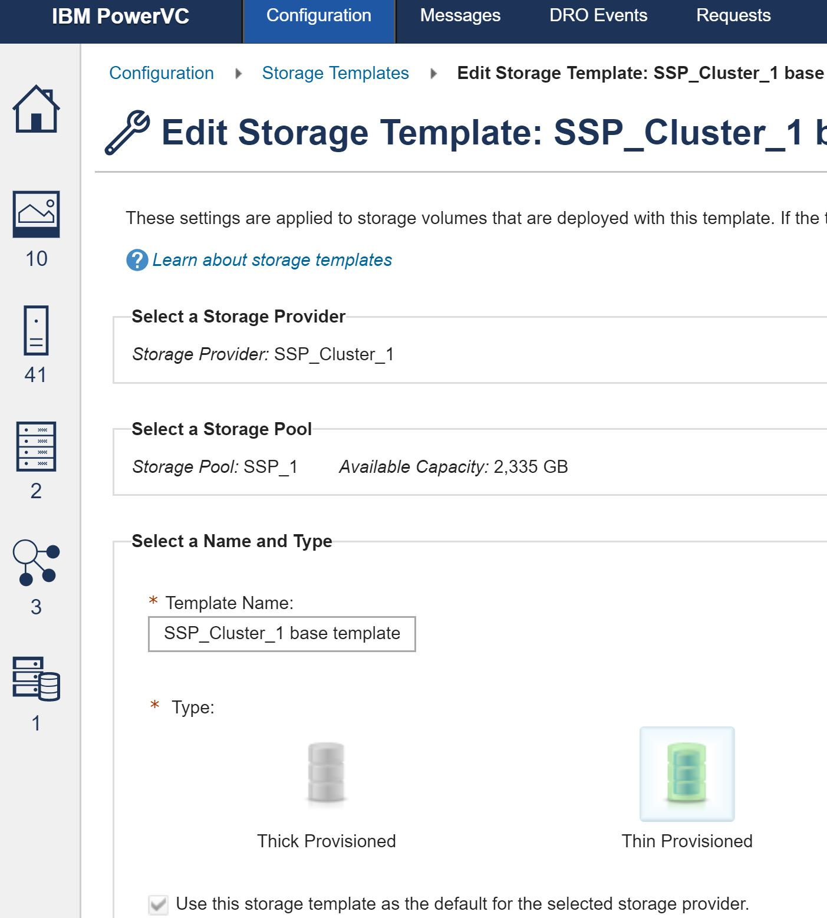

Slide 26
Storage connectivity groups
In short, it refers to a set of VIOSs with access to the same storage controllers. When a VM is created, PowerVC needs to identify which host has connectivity to the requested storage. Also, when a VM is migrated, PowerVC must ensure that the target host also provides connectivity to the volumes of the VM. The purpose of a storage connectivity group is to define settings that control how volumes are attached to VMs, including the connectivity type for boot and data volumes, physical FC port restrictions, fabrics, and redundancy requirements for VIOSs, ports, and fabrics. A storage connectivity group contains a set of VIOSs that are allowed to participate in volume connectivity.
When a VM is deployed with PowerVC, a storage connectivity group must be specified. The VM is associated with that storage connectivity group during the VM's existence. A VM can be deployed only on Power Systems hosts that satisfy the storage connectivity group settings. The VM can be migrated only within its associated storage connectivity group and host group.
The default storage connectivity group for NPIV connectivity, vSCSI connectivity and for SSP is created when PowerVC recognizes that the needed resource is needed for the management. After you add the storage providers and define the storage templates, you can create storage volumes.
Only data volumes must be created manually. Boot volumes are handled by PowerVC automatically. When you deploy a partition, IBM PowerVC automatically creates the boot volumes and data volumes that are included in the images.

Slide 27
Shared storage pool
SSPs are supported on hosts that are managed either by HMC or NovaLink. The SSP is configured manually, without PowerVC (creation of a cluster on VIO servers, adding disks to the pool). After that PowerVC will discover the SSP when it discovers the VIOSs. When a VM is created PowerVC will create logical units (LUs) in the SSP, then PowerVC instructs the VIOS to map these LUs to the VM (VIO client partition) as a vSCSI device.

Slide 28
